Slide 1
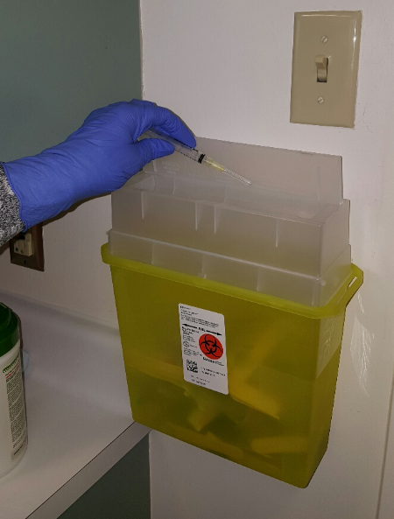
Sharps Awareness
Introduction
London Health Science Centre is committed to providing safe, timely and high quality care to patients and staff.
Preventing Sharp Injuries is Our Goal!
The course will take approximately 10 minutes to complete.
There will be a short quiz at the end of the training.

Slide 2
Sharps Awareness
Learning Objective
At the end of this module, you should be able to recognize the hazards of needle stick and sharps injuries and how they happen.
Who gets injured?
Where do they happen?
When do injuries occur?
What devices are involved?
How can they be prevented?

Slide 3
Who is at risk?
Any worker who may come in contact with needles/sharps is at risk.

Slide 4
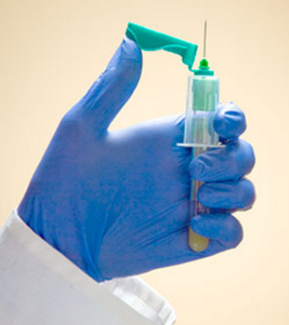
What are the hazards of needle stick and sharp injuries?
These injuries can transmit infectious diseases, especially blood-borne viruses
Accidental punctures by contaminated needles can inject hazardous fluids into the body through the skin
The risk of infection after exposure to infected blood varies by bloodborne pathogen
Preventing injuries from sharps and needlesticks is considered a part of the "routine practices" used by healthcare workers.
Notes:
IPAC link?

Slide 5
Medical VS. Non-medical Sharps
Examples reported through AEMS
Medical Sharps
Needle stick injury in/or while suturing
Gave insulin injection and poked myself afterwards
Drawing blood cultures, went to sheath needle and patient jerked, penetrated glove on left index finger and punctured skin
Non-medical Sharps
Cut my finger while opening a glass vial
Cut hand on the underside of the bed
Went to change the toner on the label printer and my hand slipped and a metal piece cut my knuckle

Slide 6
Who gets injured?
AEMS data January 1, 2016 to December 31, 2016

Slide 7
Who gets injured?
AEMS data January 1, 2016 to December 31, 2016

Slide 8
Where do sharp injuries occur?
Medical Sharps
Patient Room/Bay | 43%
Other | 19%
Treatment/Procedural/Diagnostic Area | 17%
Unspecific | 6%
Clinical Support Area | 3%
Equipment Room | 2%
Examining Room | 2%
Hallway | 2%
Outpatient Clinic | 2%
Morgue | 1%
Communication Desk | 1%
Bathroom | 0.35%
OT or PT Treatment Area | 0.35%
Other Hospital Grounds | 0.35%
Non-medical Sharps
Patient Room/Bay | 11%
Other | 9%
Treatment/Procedural/Diagnostic Area | 8%
Hallway | 5%
Unspecific | 4%
Communication Desk | 4%
Examining Room | 3%
Bathroom | 2%
Equipment Room | 2%
Office | 1%
Stairs/Stairwell | 1%

Slide 9
What Devices are involved in Sharp Injuries?
Medical Sharps
Non Medical Sharps

Slide 10
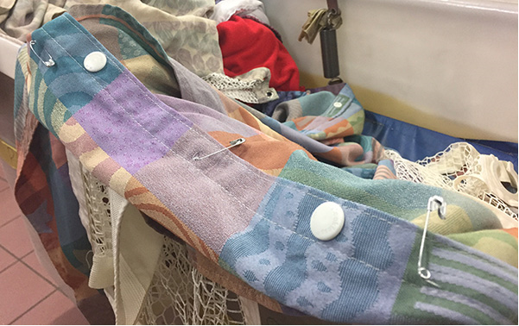
Work Practices
Injuries can occur because of the following:
Sharps left in unusual places: laundry, food trays, garbage or over-filled sharps containers
Passing or transferring equipment
Colliding with coworkers
Decontaminating/processing used equipment
Disposal of glass
Warning from LHSC Customer Support Services Broadcast
Bedsides with open safety pins can lead to puncture injuries to linen service workers

Slide 11
Needle safety legislation
Provision of safety-engineered needles
3. (1) When a worker is to do work requiring the use of a hollow-bore needle, the employer shall provide the worker with a safety-engineered needle that is appropriate for the work. O. Reg. 474/07, s. 3 (1).
(2) Subsection (1) does not apply if the employer is unable, despite making efforts that are reasonable in the circumstances, to obtain a safety-engineered needle that is appropriate for the work. O. Reg. 474/07, s. 3 (2).

Slide 12
Examples of how to use a SEMD
After injection immediately activate the shielding mechanism

Slide 13
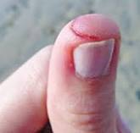
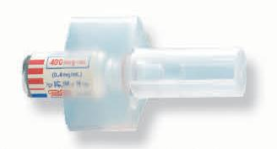
Not using Ampule Breaker
Staff can cut their thumb and finger when the glass ampule shatters or exposes a sharp edge.

Slide 14
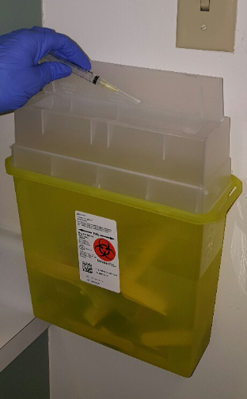
Disposal of Medical Sharps
Ensure the sharp has completely entered into the appropriate puncture resistant container during the disposal process
Do not recap, purposely bend/break or manipulate needles and other sharps in any way, unless specific measures and procedures have been approved in consultation with OHSS
Dispose medical sharps immediately after use in a proper medical sharp puncture resistant container (e.g. yellow for biohazards, red for cytotoxic) at the nearest point of use

Slide 15
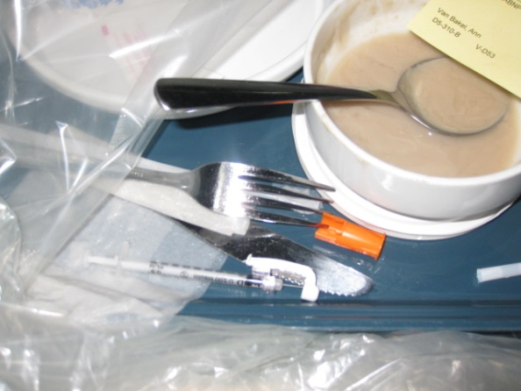
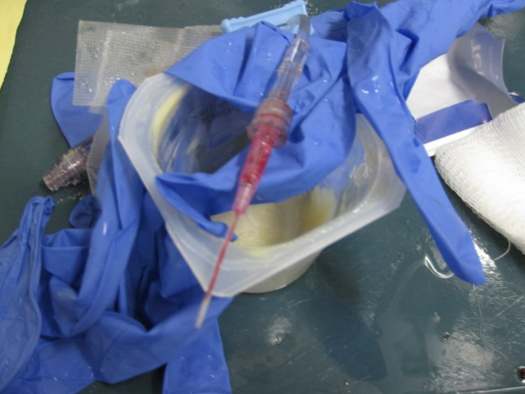
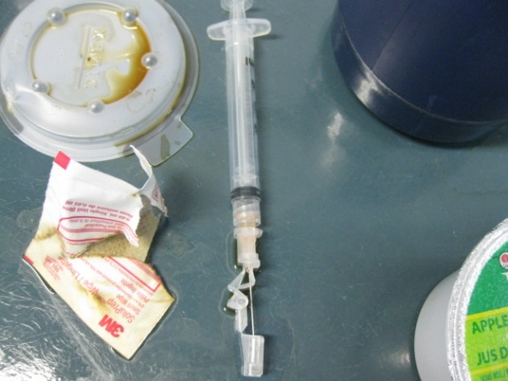
Examples of medical sharps left on food trays at LHSC

Slide 16
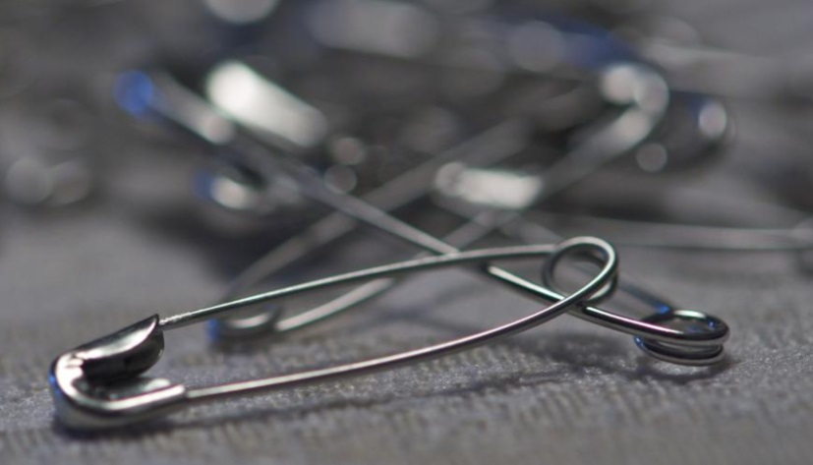
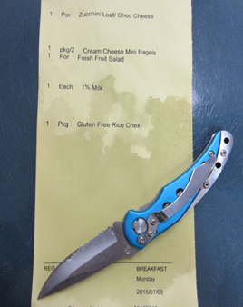
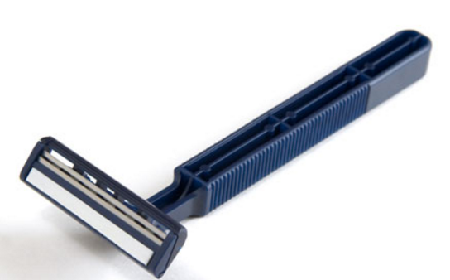
Example of non medical sharps left on food trays

Slide 17
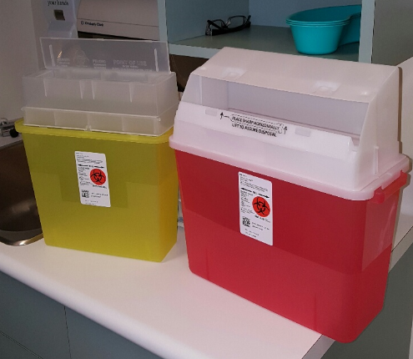
Improper Storage
Lids should be closed at all times
Lids closed at all times

Slide 18
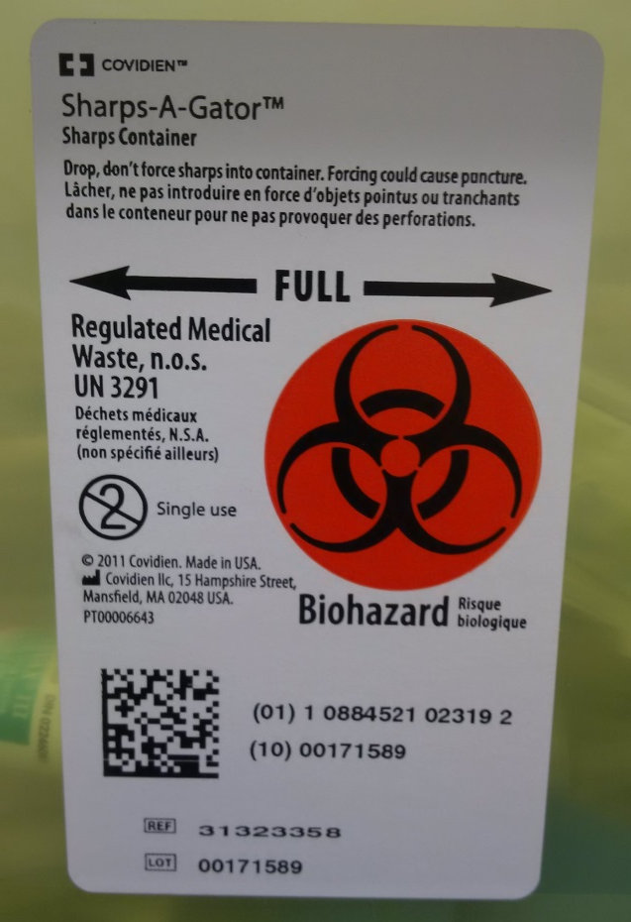
Over-filled sharps container

Slide 19
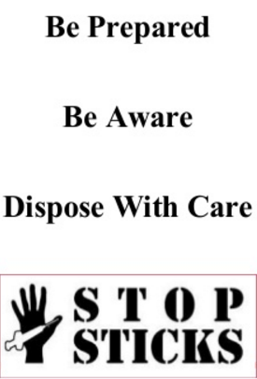
Sharps Safety Practices
Avoid bringing the hands close to the opening of a sharps container. Never place hands or fingers into a container to facilitate disposal of a device
Be accountable for sharps you use
Check procedure trays, waste materials, and bedding for exposed sharps before handling
Look for sharps/equipment left behind inadvertently
From CDC Workbook for Designing, Implementing and Evaluating a Sharps Injury Prevention Program April 16, 2008

Slide 20
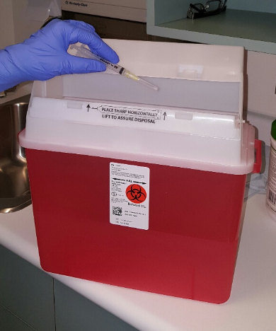
Disposal of Sharps Containers
Close and immediately secure the puncture resistant container when it is ¾ full (see fill line on container) and follow department guidelines for replacement and waste disposal
Red containers are used for all biological and cytotoxic waste
Full containers are disposed of in accordance with applicable legislation
Ensure all sharps containers have a biohazard label affixed to the containers prior to disposal, this would also include 20 litre pails

Slide 21
You are Part of the Prevention Process when you:
Follow safe practices and assist and support coworkers in safer practices
Report injuries or blood/body fluid exposures, sharps injury hazards, and near misses at https://aems.lhsc.on.ca/Default.asp
If you are not sure how to dispose please contact your leader for instruction
Participate in training for devices and properly use sharps safety features. Notify your leader as soon as possible if you have not received the required training

